Slide 1

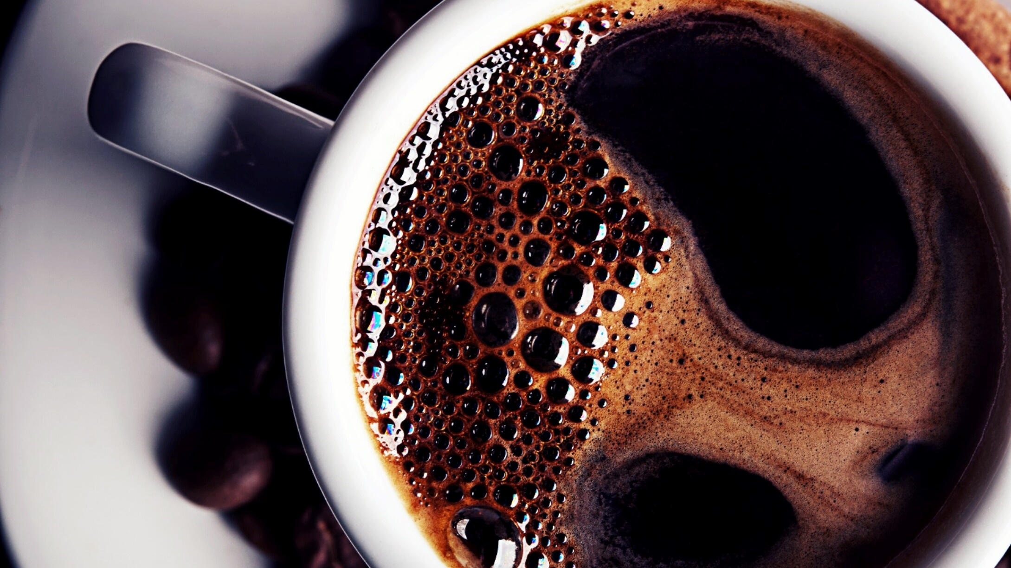
Value Stream Mapping(VSM)
Dan Zhu
CSD-380 Module 5.2
9/12/2025

Slide 2
Morning Routine of Get My Kid to School
Morning Start
Get Dressed
Check Backpack
Prepare Breakfast
Fresh Up
Walk to Bus Stop
Waking Him Up
Eat Breakfast
Get on Bus

Slide 3
Estimated Average Flow Time
Morning Start | 30 mins
Prepare Breakfast | 20 mins
Waking Him Up | 10 mins
Get Dressed | 10 mins
Fresh Up | 10 mins
Eat Breakfast | 30 mins
Check Backpack | 10 mins
Walk to Bus Stop | 5 mins
Get on Bus | 2 mins
Estimated Cycle Time | 2 hours 7 mins

Slide 4
Optimize My Processes
Eliminating Waste
I can eliminate 10 minutes from morning start if I read news after he went to school. I can eliminate 5 minutes if I wake him up before I start preparing breakfast. I can eliminate 5 minutes if I check his backpack the night before.
Workflow Orchestration
If I move check backpack the night before, I can check his staff and pack the snacks. It will make more sense. If he can get dressed and fresh up while I am preparing breakfast. It will be more efficient.
Workflow Orchestration
The vulnerability assessment uncovers is that my kid does not do what I think he suppose to do while I am preparing breakfast.

